Slide 1
Spatial Models 2
AIMS Day 2

Slide 2
Today
Discuss ”Lagrangian” models
Discuss potential sources of data we can use to inform spatial models

Slide 3

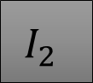
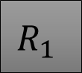

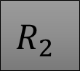


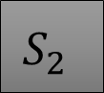

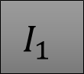


$$S_{1}$$
$$I_{1}$$
$$R_{1}$$
$$S_{1}$$
$$I_{1}$$
$$R_{1}$$
$$S_{2}$$
$$I_{2}$$
$$R_{2}$$
$$S_{2}$$
$$I_{2}$$
$$R_{2}$$
We move people physically from one area to another
Some S1 individuals move to patch 2 and become S2, etc
Transmission only occurs within patch
I2 individuals can only infect S2
People always stay in the same place
Cross-community transmission occurs
I2 can infect S1, but probably at a much lower contact rate than I2 to S2
“Eulerian” movement
“Lagrangian” movement

Slide 4
$$S_{1}$$
$$I_{1}$$
$$R_{1}$$
$$S_{1}$$
$$I_{1}$$
$$R_{1}$$
$$S_{2}$$
$$I_{2}$$
$$R_{2}$$
$$S_{2}$$
$$I_{2}$$
$$R_{2}$$
We move people physically from one area to another
Some S1 individuals move to patch 2 and become S2, etc
Transmission only occurs within patch
I2 individuals can only infect S2
People always stay in the same place
Cross-community transmission occurs
I2 can infect S1, but probably at a much lower contact rate than I2 to S2
“Eulerian” movement
“Lagrangian” movement

Slide 5
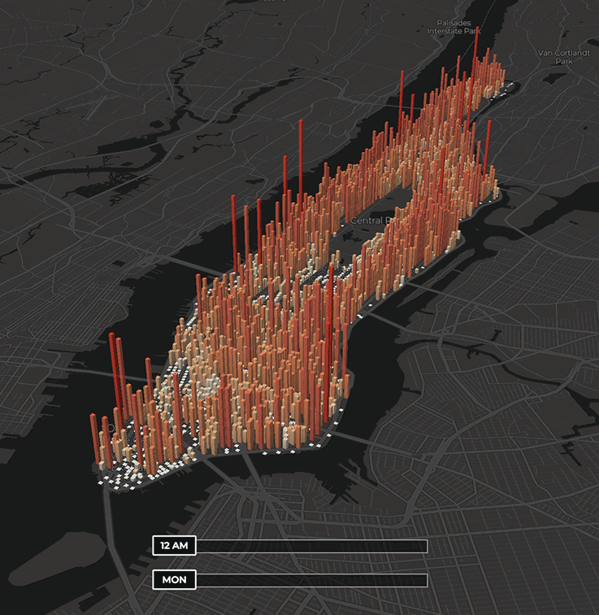
Changing exposure
Associate people with a resident patch, but model exposure in other patches
Always associated with home patch
Shorter-distance spread and mobility: Neighborhoods, nearby cities

Slide 6
Changing exposure
Susceptible
Infected

Slide 7
Changing exposure
Susceptible
Infected

Slide 8
Changing exposure
Susceptible
Infected

Slide 9
Changing exposure
Susceptible
Infected

Slide 10
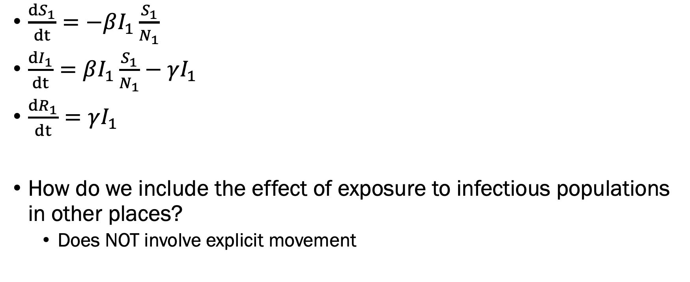
Changing exposure
$\frac{dS_{1}}{dt}=−βI_{1}\frac{S_{1}}{N_{1}}$
$\frac{dI_{1}}{dt}=βI_{1}\frac{S_{1}}{N_{1}}−γI_{1}$
$\frac{dR_{1}}{dt}=γI_{1}$
How do we include the effect of exposure to infectious populations in other places?
Does NOT involve explicit movement

Slide 11
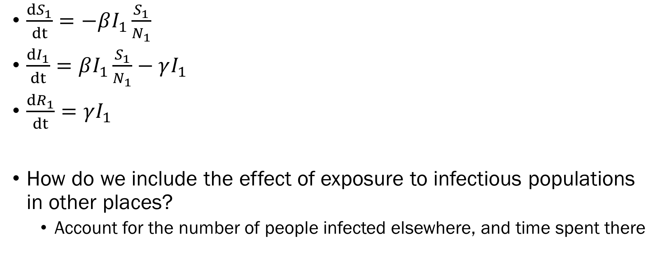
Changing exposure
$\frac{dS_{1}}{dt}=−βI_{1}\frac{S_{1}}{N_{1}}$
$\frac{dI_{1}}{dt}=βI_{1}\frac{S_{1}}{N_{1}}−γI_{1}$
$\frac{dR_{1}}{dt}=γI_{1}$
How do we include the effect of exposure to infectious populations in other places?
Account for the number of people infected elsewhere, and time spent there
Here, transmission is coming entirely from infectious people in patch 1

Slide 12
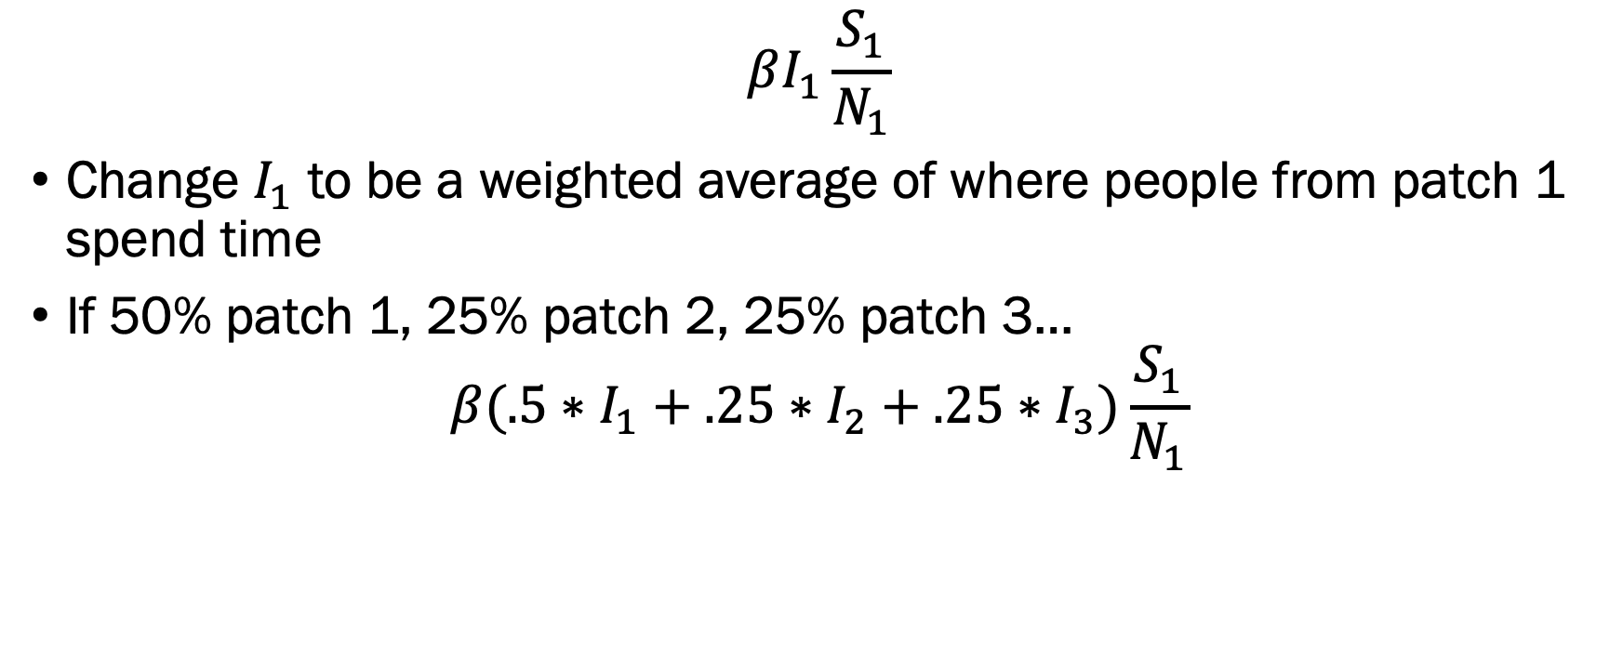
Changing exposure
$$βI_{1}\frac{S_{1}}{N_{1}}$$
Change $I_{1}$ to be a weighted average of where people from patch 1 spend time
If 50% patch 1, 25% patch 2, 25% patch 3…
$$β(.5∗I_{1}+.25∗I_{2}+.25∗I_{3})\frac{S_{1}}{N_{1}}$$

Slide 13
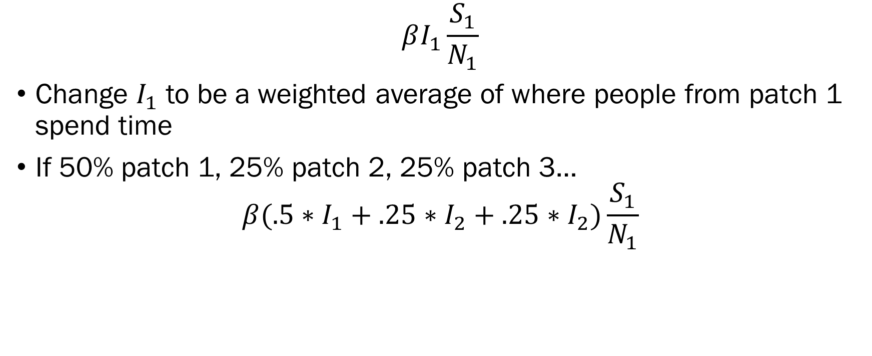
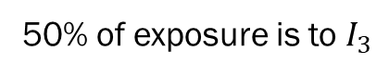
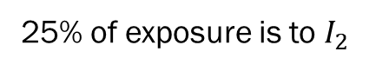
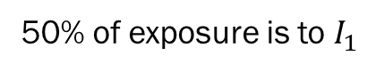
Changing exposure
$$βI_{1}\frac{S_{1}}{N_{1}}$$
Change $I_{1}$ to be a weighted average of where people from patch 1 spend time
If 50% patch 1, 25% patch 2, 25% patch 3…
$$β(.5∗I_{1}+.25∗I_{2}+.25∗I_{2})\frac{S_{1}}{N_{1}}$$
50% of exposure is to $I_{1}$
25% of exposure is to $I_{2}$
50% of exposure is to $I_{3}$

Slide 14
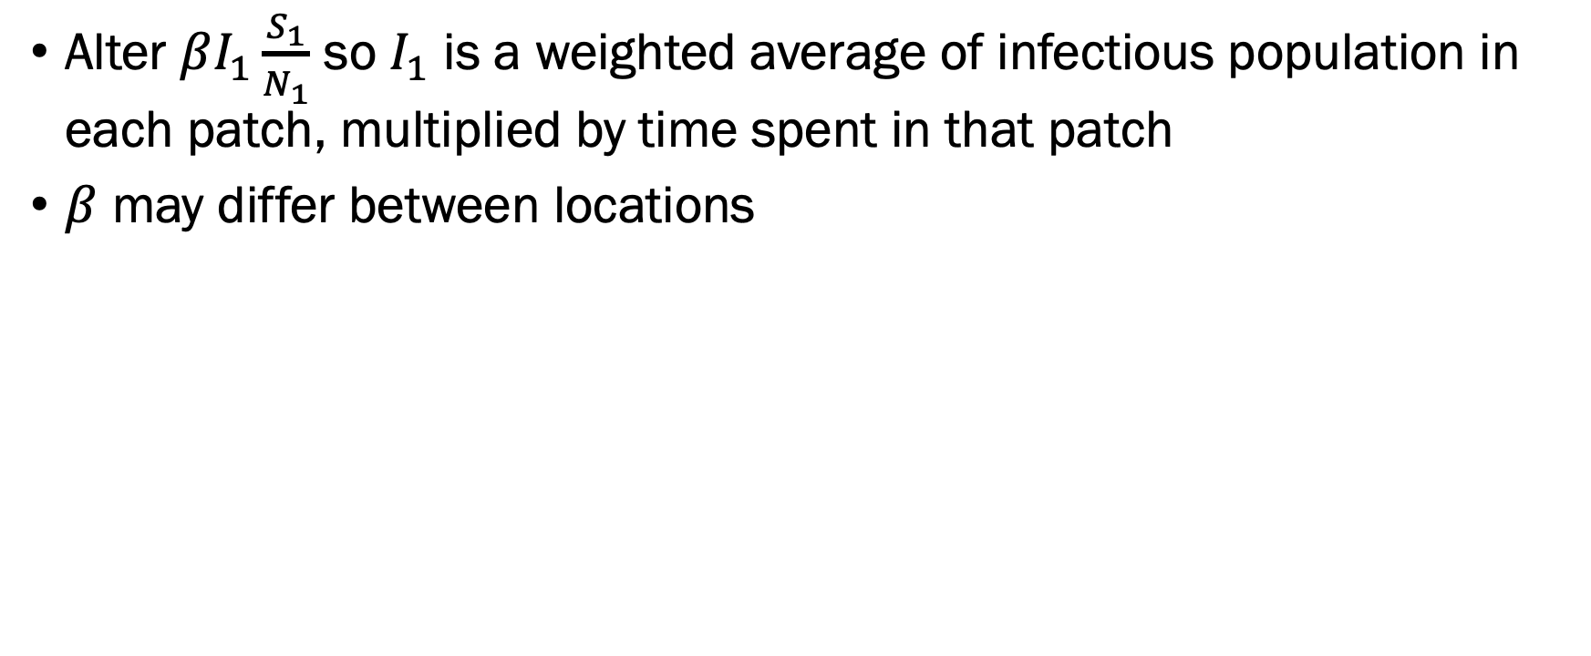
Changing exposure
Alter $βI_{1}\frac{S_{1}}{N_{1}}$ so $I_{1}$ is a weighted average of infectious population in each patch, multiplied by time spent in that patch
$β$ may differ between locations

Slide 15




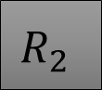

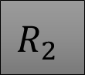
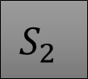
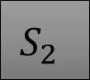



Two ways to account for space & mobility
“Eulerian” movement
“Lagrangian” movement
$$S_{1}$$
$$I_{1}$$
$$R_{1}$$
$$S_{1}$$
$$I_{1}$$
$$R_{1}$$
$$S_{2}$$
$$I_{2}$$
$$R_{2}$$
$$S_{2}$$
$$I_{2}$$
$$R_{2}$$
Moves people explicitly, when they move they are associated with a new place
Models exposure, tracks “home location”

Slide 16
Worksheet discussion
What did you observe with/without movement?
What do you think was happening?

Slide 17
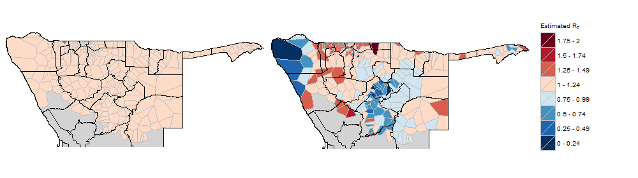
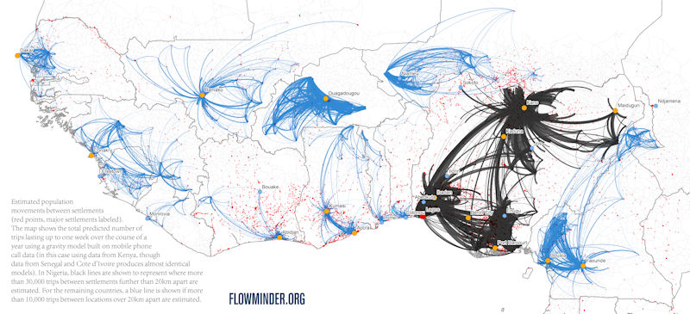
How do we use mobility to combat disease?
Identify areas that are receiving lots of cases, or exporting lots of cases
Predict how quickly disease will spread during an outbreak
Identify potential superspreaders, which communities/people infected people will visit
Social network analysis

Slide 18
Which is more appropriate?
Eulerian: Physically moves people between patches; longer-term mobility
Lagrangian: Exposure-based, time spent in places; retain residence
Each carries pros/cons
Which would you think to use for the following:
Malaria transmission within a province, where people may travel to nearby places with high mosquito densities during the day
Spread of an emerging disease from one country to another
Neighborhood-level spread of dengue

Slide 19
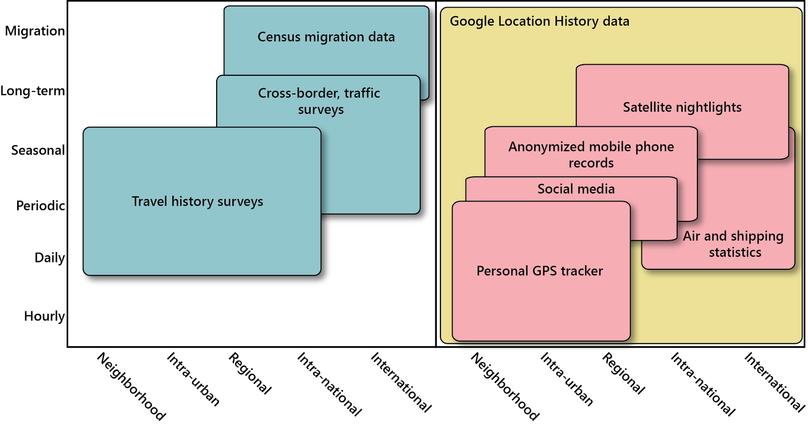
The other pieces…
Not all data fit for the question considered
Ex. GPS tracker data: Very detailed, but often only cover 1-2 weeks
Shipping statistics: Cover long periods but not spatially refined

Slide 20
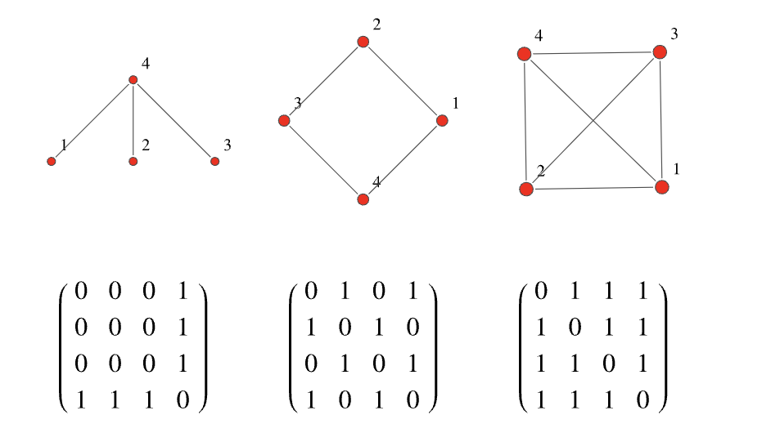
The other pieces…
What kind of model does your data permit?
Typically, reported as “adjacency matrices”

Slide 21
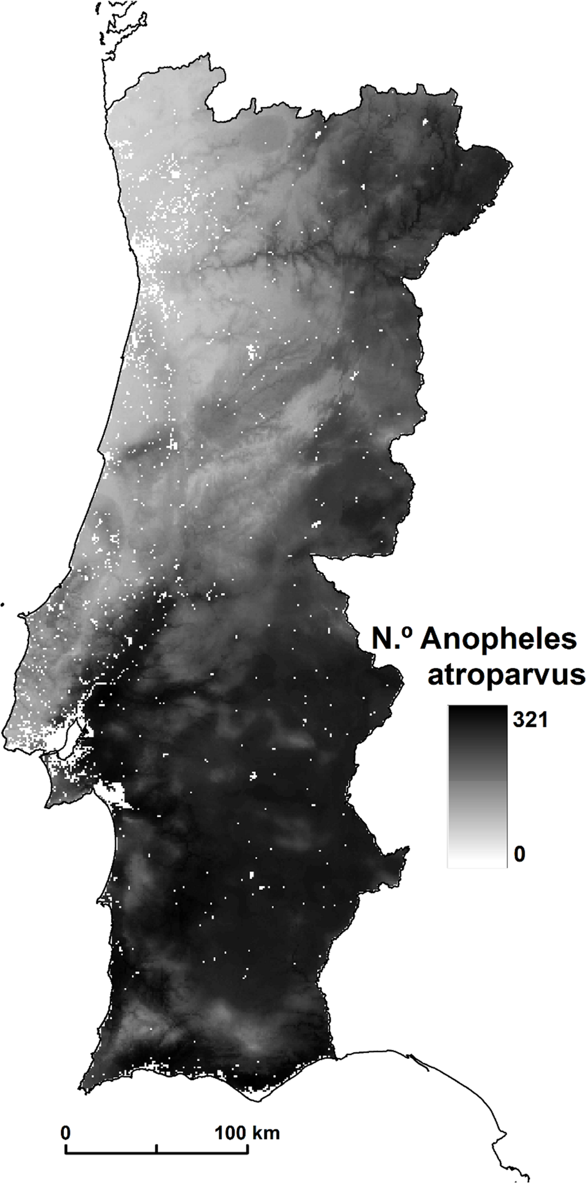
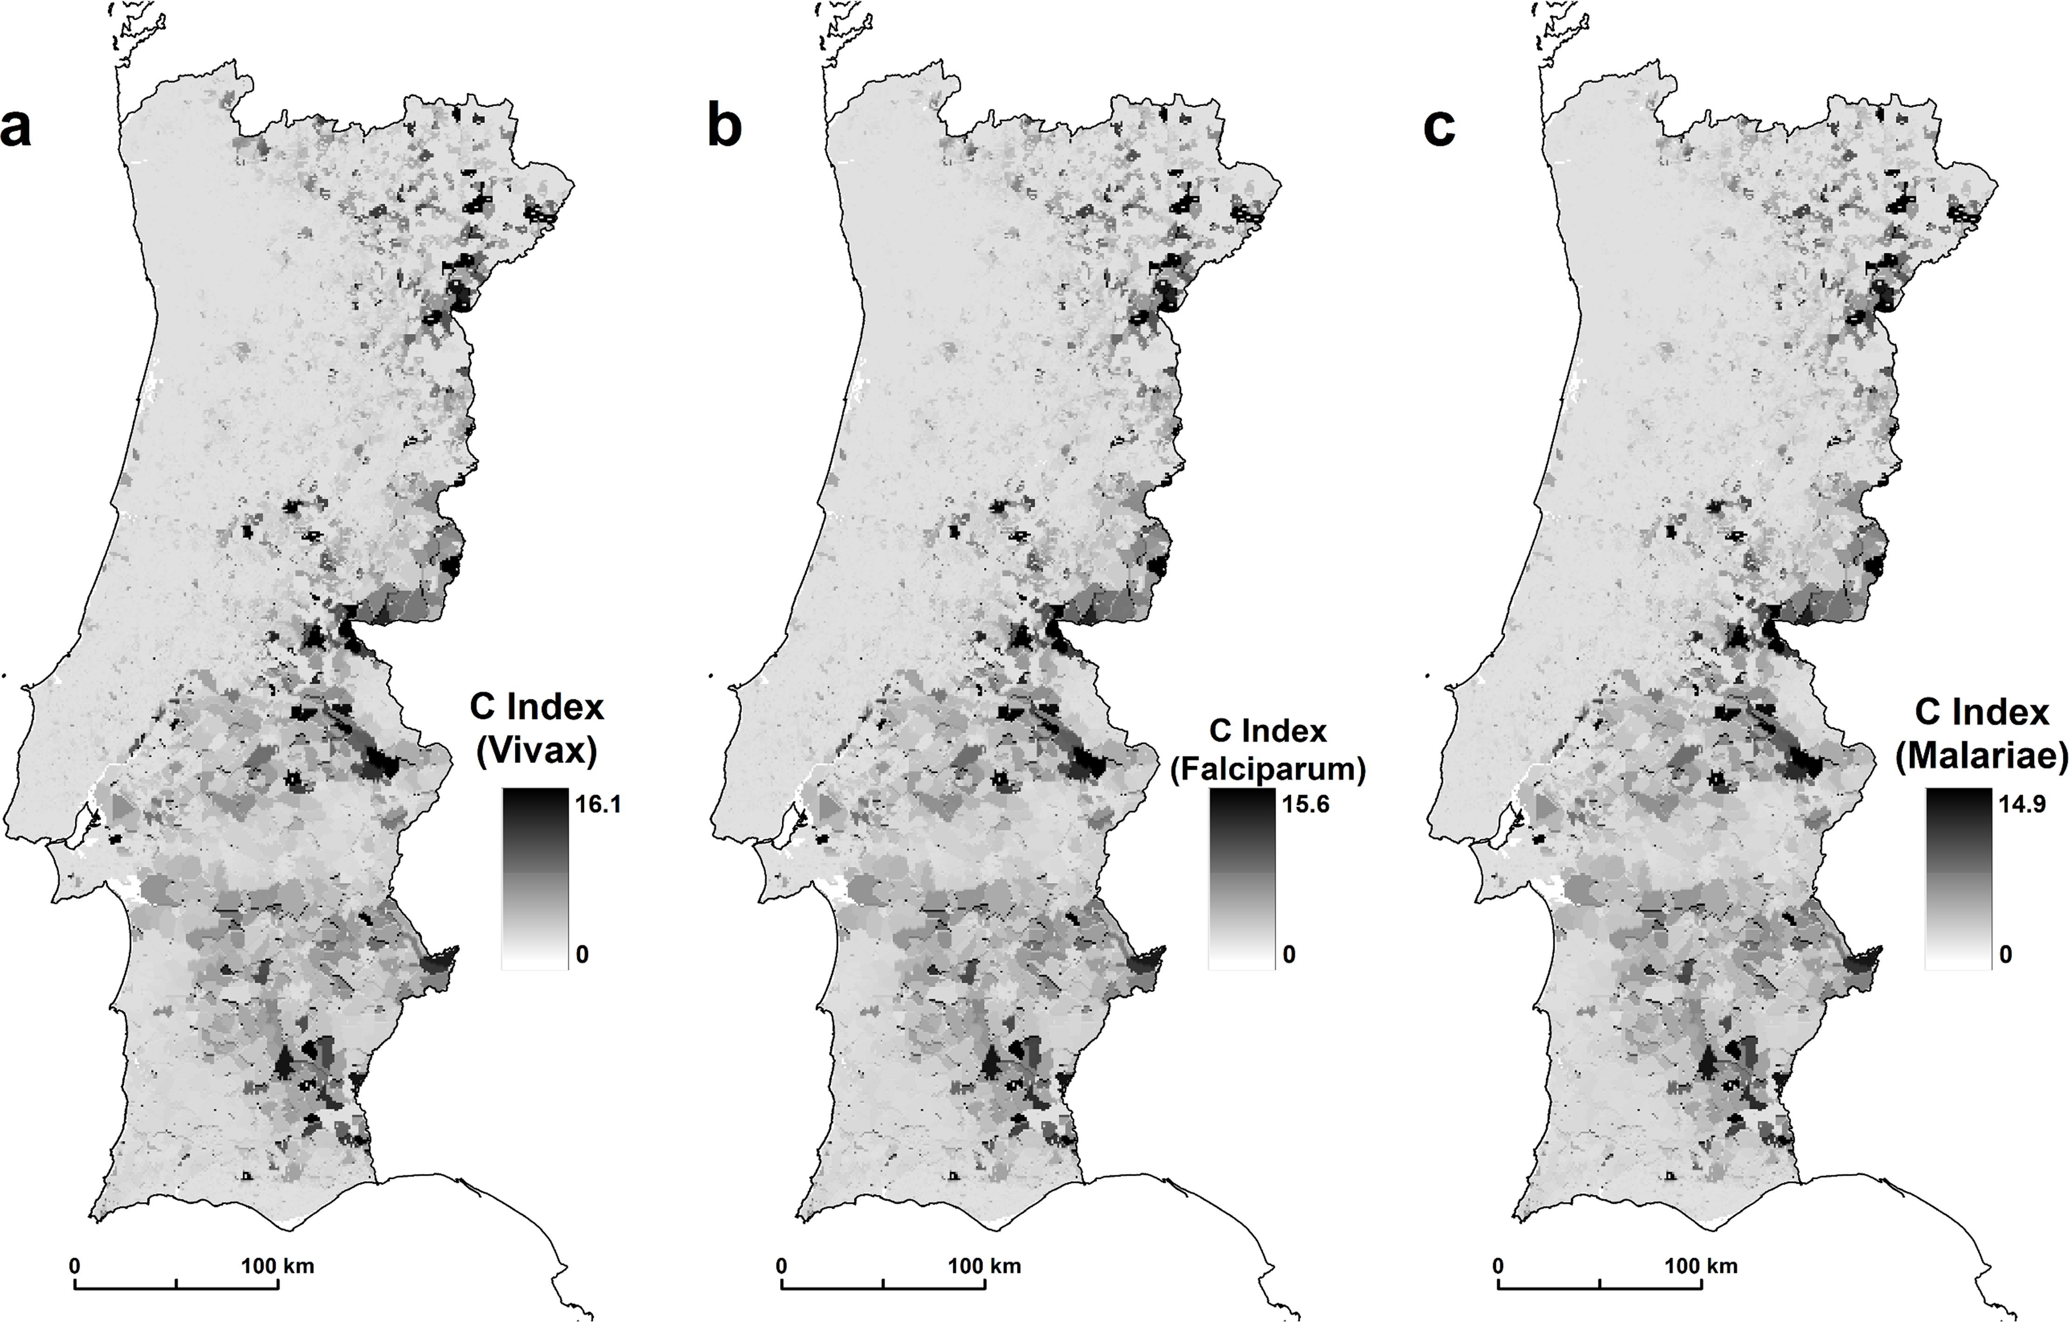
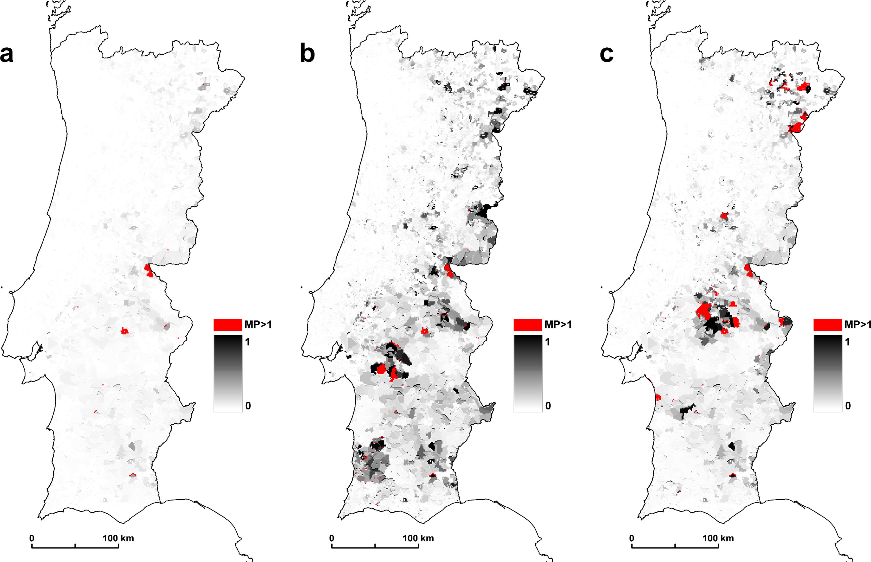
The other pieces…
Is there spatial variation in transmission rate?
How can you estimate this?
Mapping Risk of Malaria Transmission in Mainland Portugal Using a Mathematical Modelling Approach

Slide 22
Spatial variation in transmission
Occurs for a variety of reasons
Vector density
Population density
Social/cultural/economic factors

Slide 23
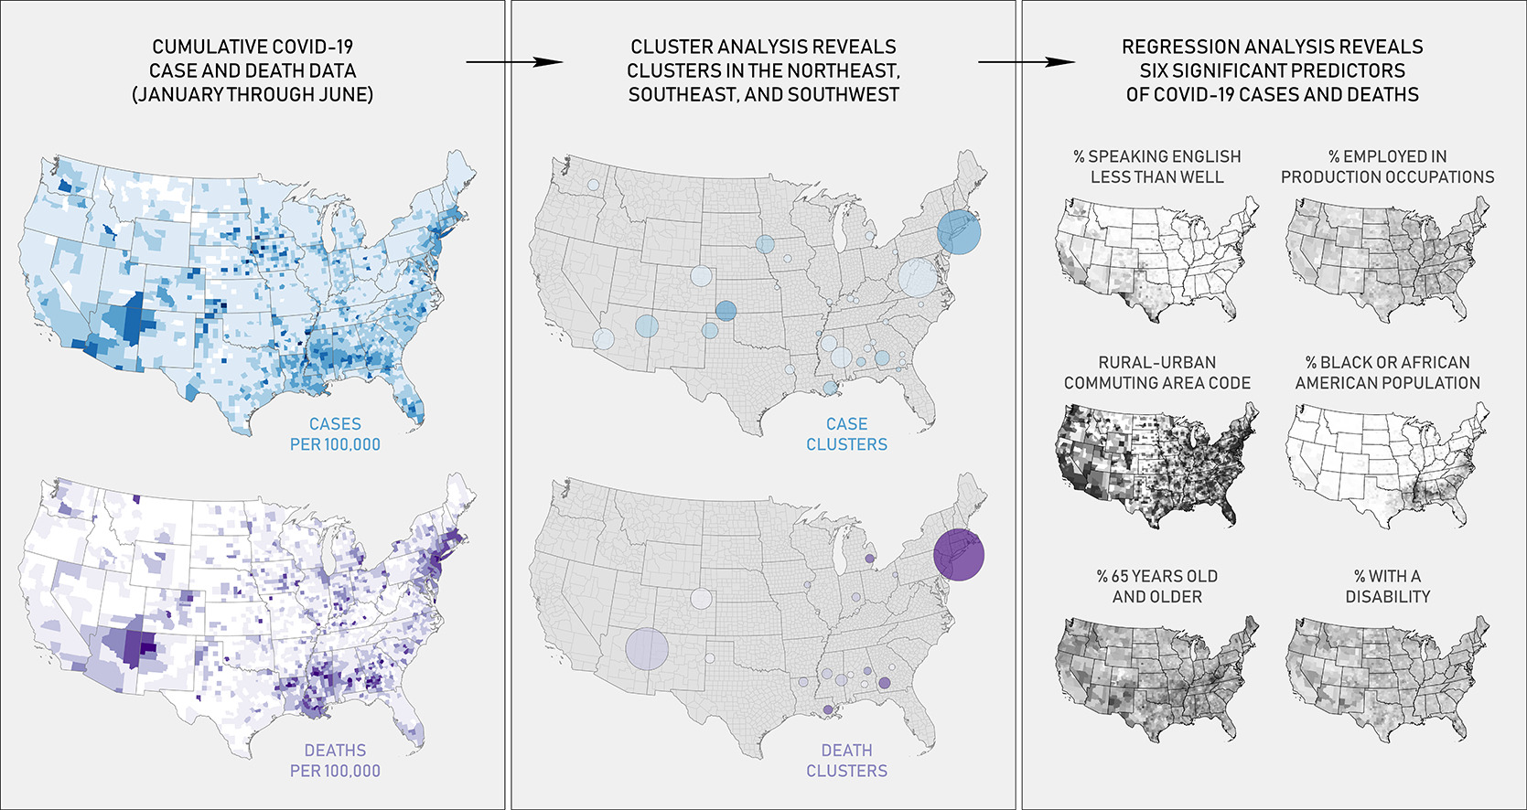
Analyzing the spatial determinants of local Covid-19 transmission in the United States

Slide 24
Putting the pieces together…
When we formulate our model we ask…
What population am I modeling?
What interventions do I want to model?
What is a reasonable patch size?
Important to consider intervention potential
What data can I reasonably obtain?
Mobility data
Spatial data
Intervention efficacy data
Then–What kind of model would I want to use?

Slide 25

Europe in a multipatch SEIR model
Exit strategies and international cooperation
What is the difference between synchronized and asynchronized phased lockdowns?
https://www.science.org/doi/10.1126/science.abc5096

Slide 26
Europe in a multipatch SEIR model
To parameterize a multipatch SEIR model, we need:
Movement between countries
Relative rates of transmission per country
Effectiveness of interventions

Slide 27
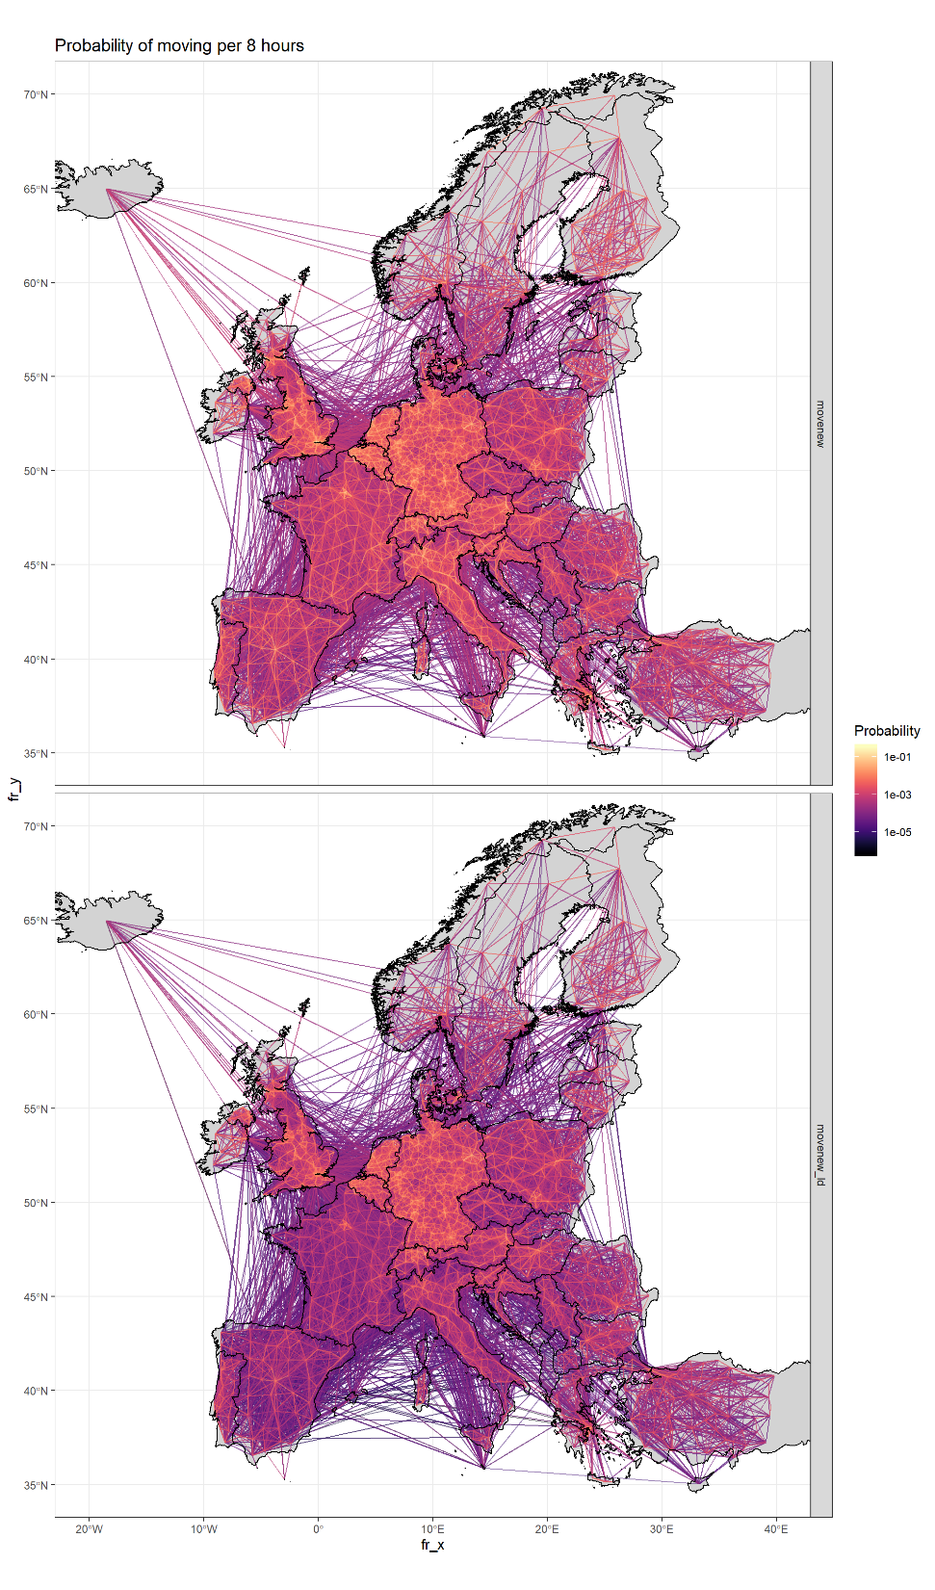
Movement between countries
Data: Mobile phone/Smartphone data
Baseline patterns, Jan-Feb 2020
Vodafone Group; Italy & Spain
Probabilities of moving between NUTS3 areas
Smartphone data; continent-wide
Relative population flows
Predict 8-hour probabilities of moving in Vodafone data using smartphone relative flows

Slide 28
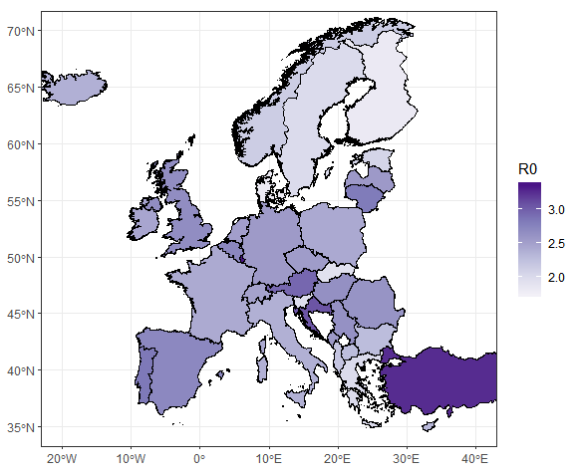
Relative rates of transmission per country
Data: Cases over time
Infer transmission rate per country using machine learning approach

Slide 29
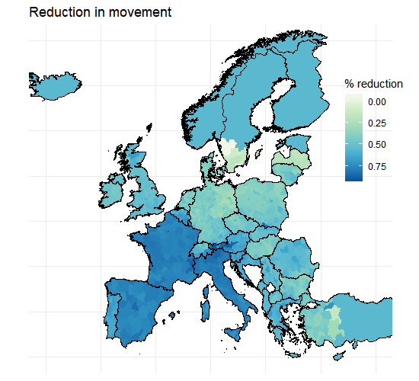
Lockdown effectiveness
Data: Relative movement on March 28, compared to Jan-Feb 2020
Smartphone data

Slide 30
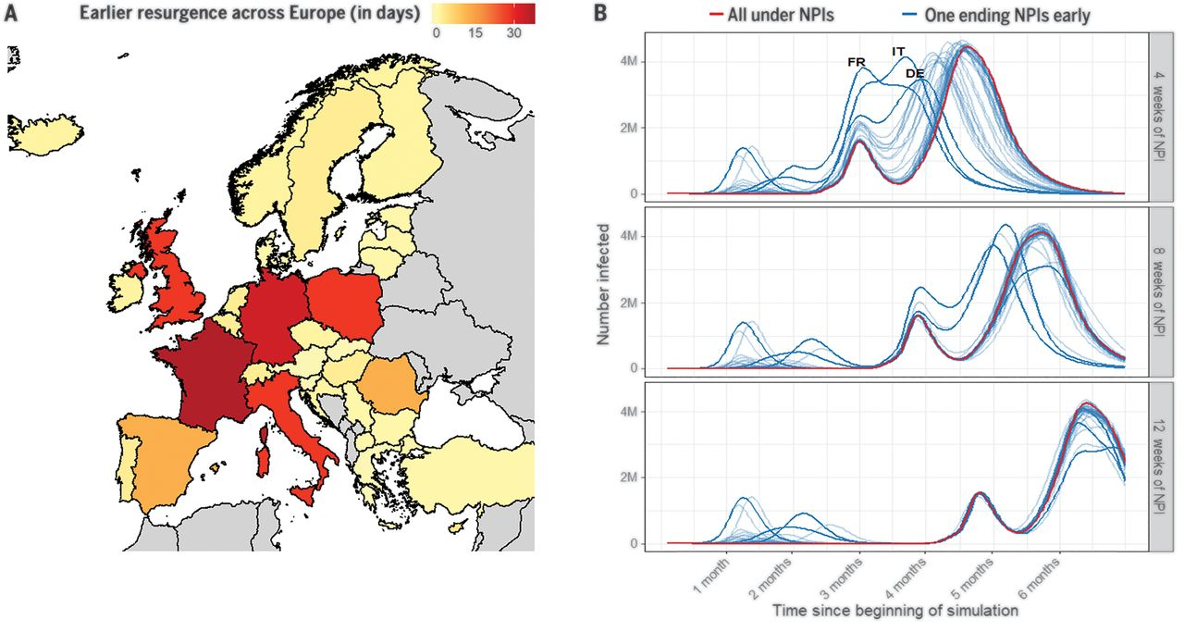

Slide 31
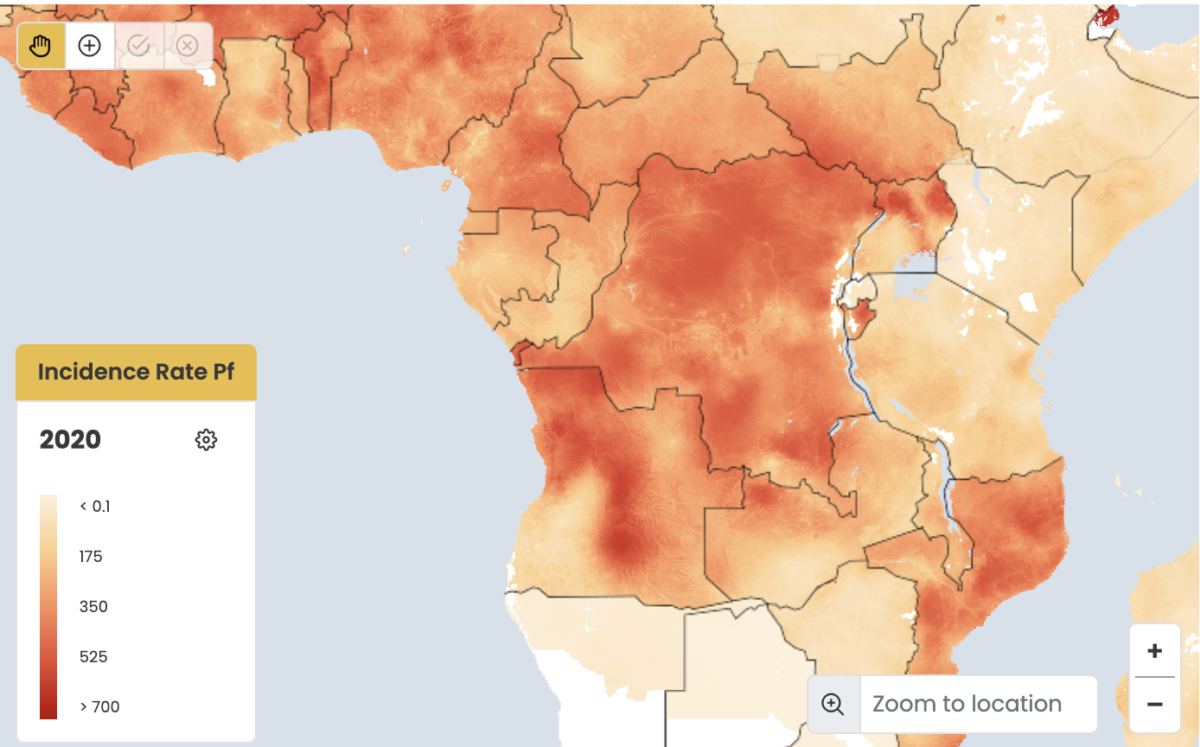
Where could I find data?
Transmission capacity data
Use tools to fit localized R0
Use vector capacity grids
Often, geostatisticians work on this problem

Slide 32
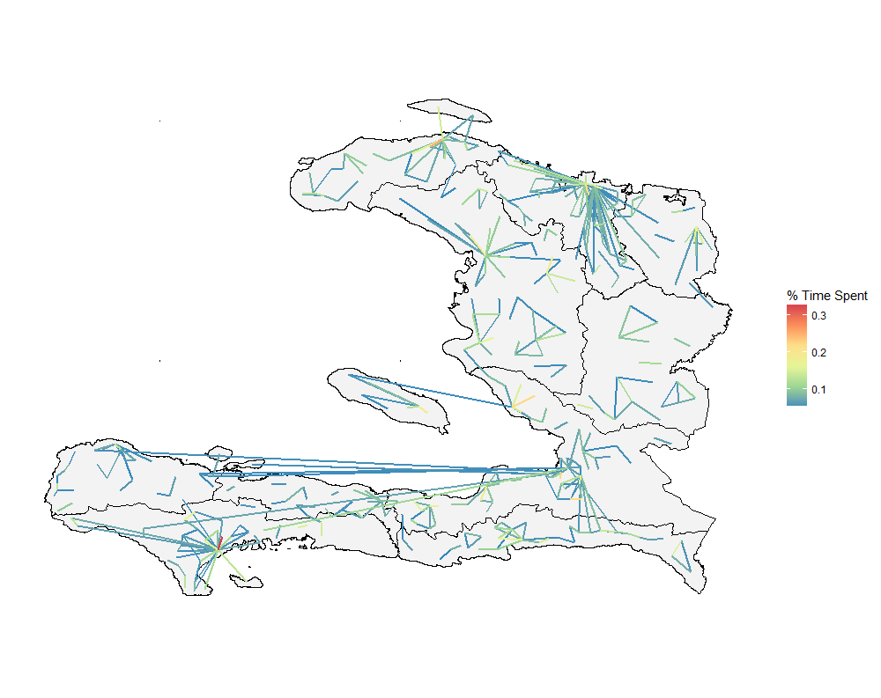
Where could I find data?
Mobility data
Surveys
Call detail records
Census
Smartphone data
Each carries pros/cons
Mobility models
Gravity models

Slide 33
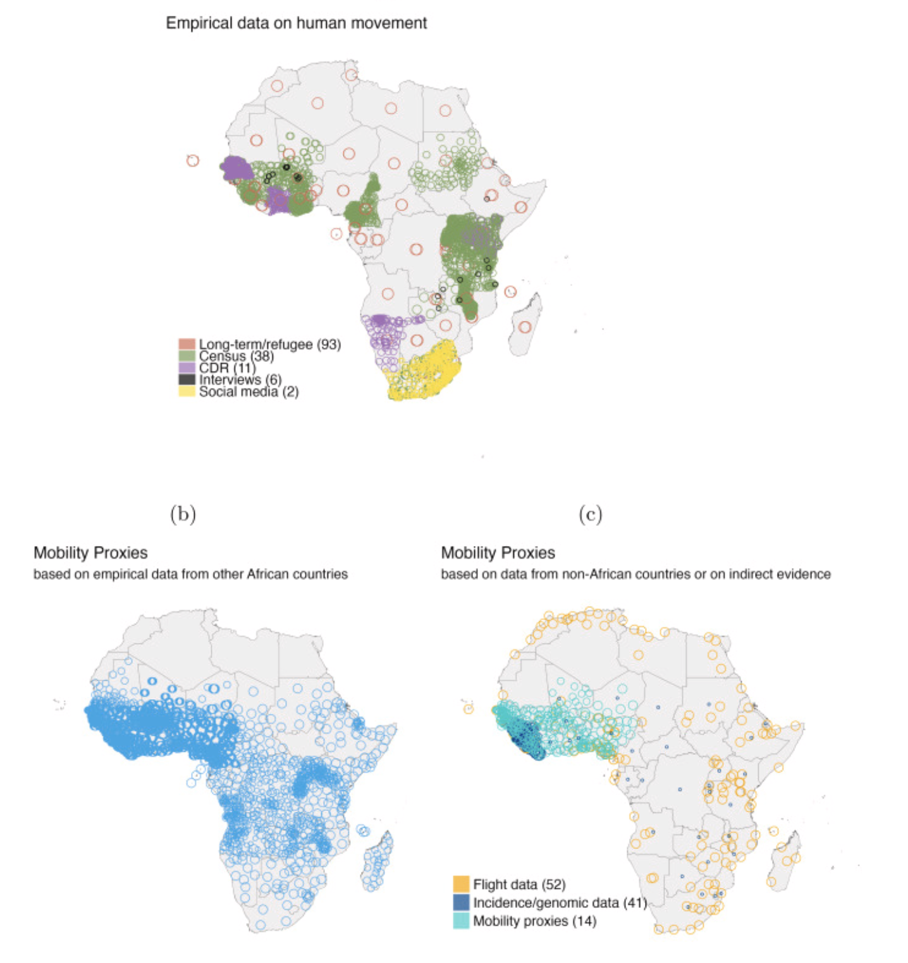
Gaps in mobility data and implications for modelling epidemic spread: A scoping review and simulation study
https://www.sciencedirect.com/science/article/pii/S1755436523000026

Slide 34
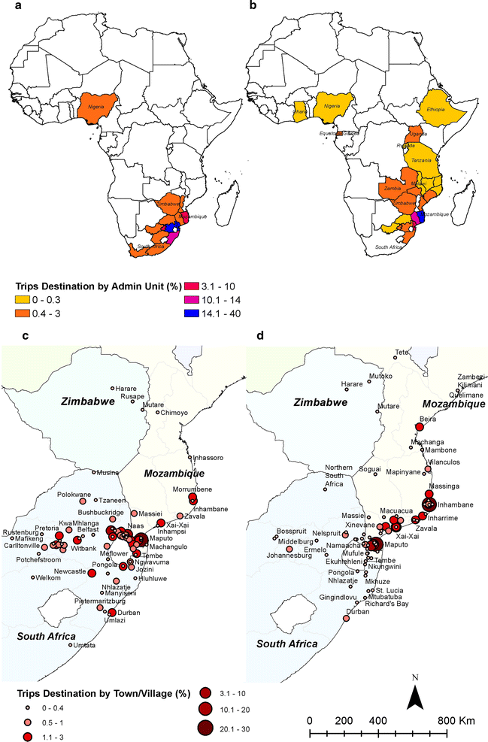
Travel history surveys
Surveys of people with malaria or the general population – travel in the past 6 weeks
+ Relevant population and parasite movements, domestic and international, temporal trends
- Not collected in many settings, difficult to access, inconsistent coverage/quality, incomplete picture

Slide 35

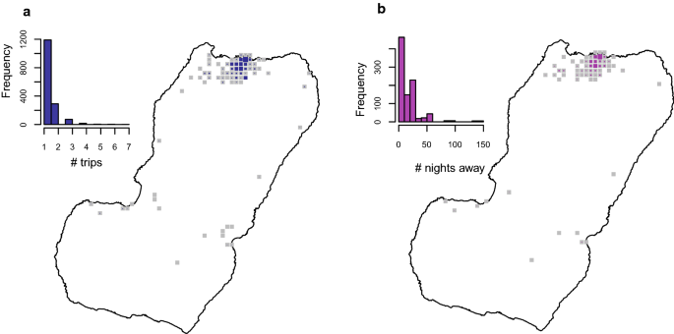
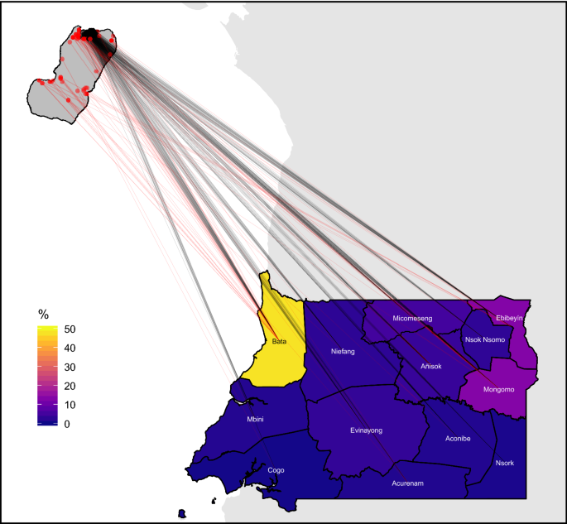

Slide 36
Census
5 year migration
From IPUMS; available for many countries
Some international mobility, but only at country-level
+ Available for many countries, representative
- Long-term mobility only
Sorichetta, A

Slide 37
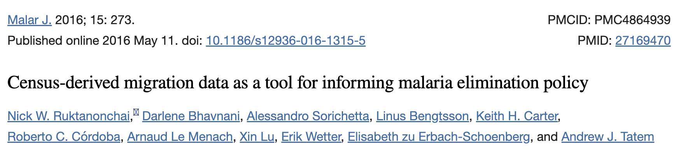
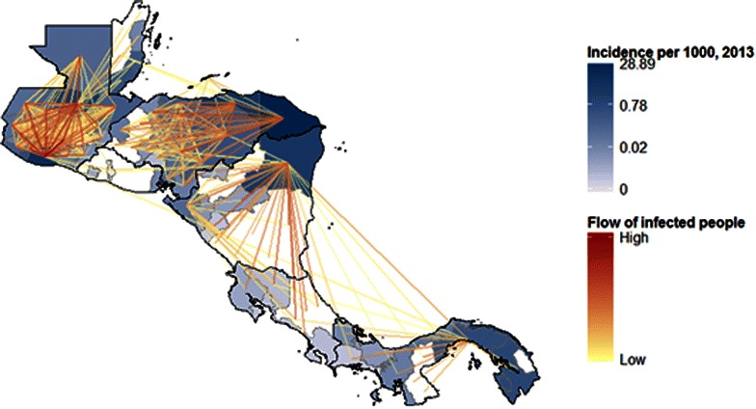

Slide 38
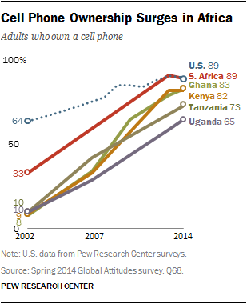
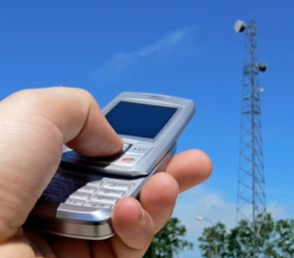
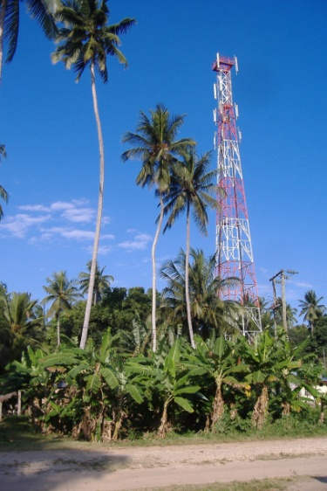
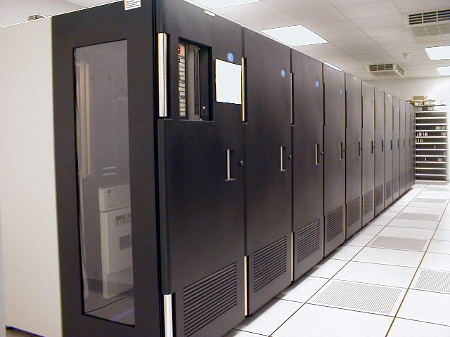
Call detail records
Call/text event
X
Call/text routed through tower x
Calls over time
A
B
B
B
C
B
Mobile phone tower
Mapping location & movement
A
B
A
B
A
B
C
C
C
Network operator
Records time and tower location

Slide 39
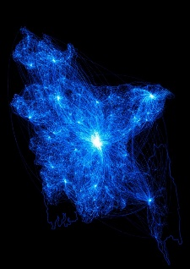
Call detail records
+ Rich spatiotemporal data on national movements, captures seasonality, long time series
- Difficult to access and share, biased, anonymous, no cross-border info
Valuable for national-scale analyses, assessing distributions, connectivity, time spent, seasonality

Slide 40
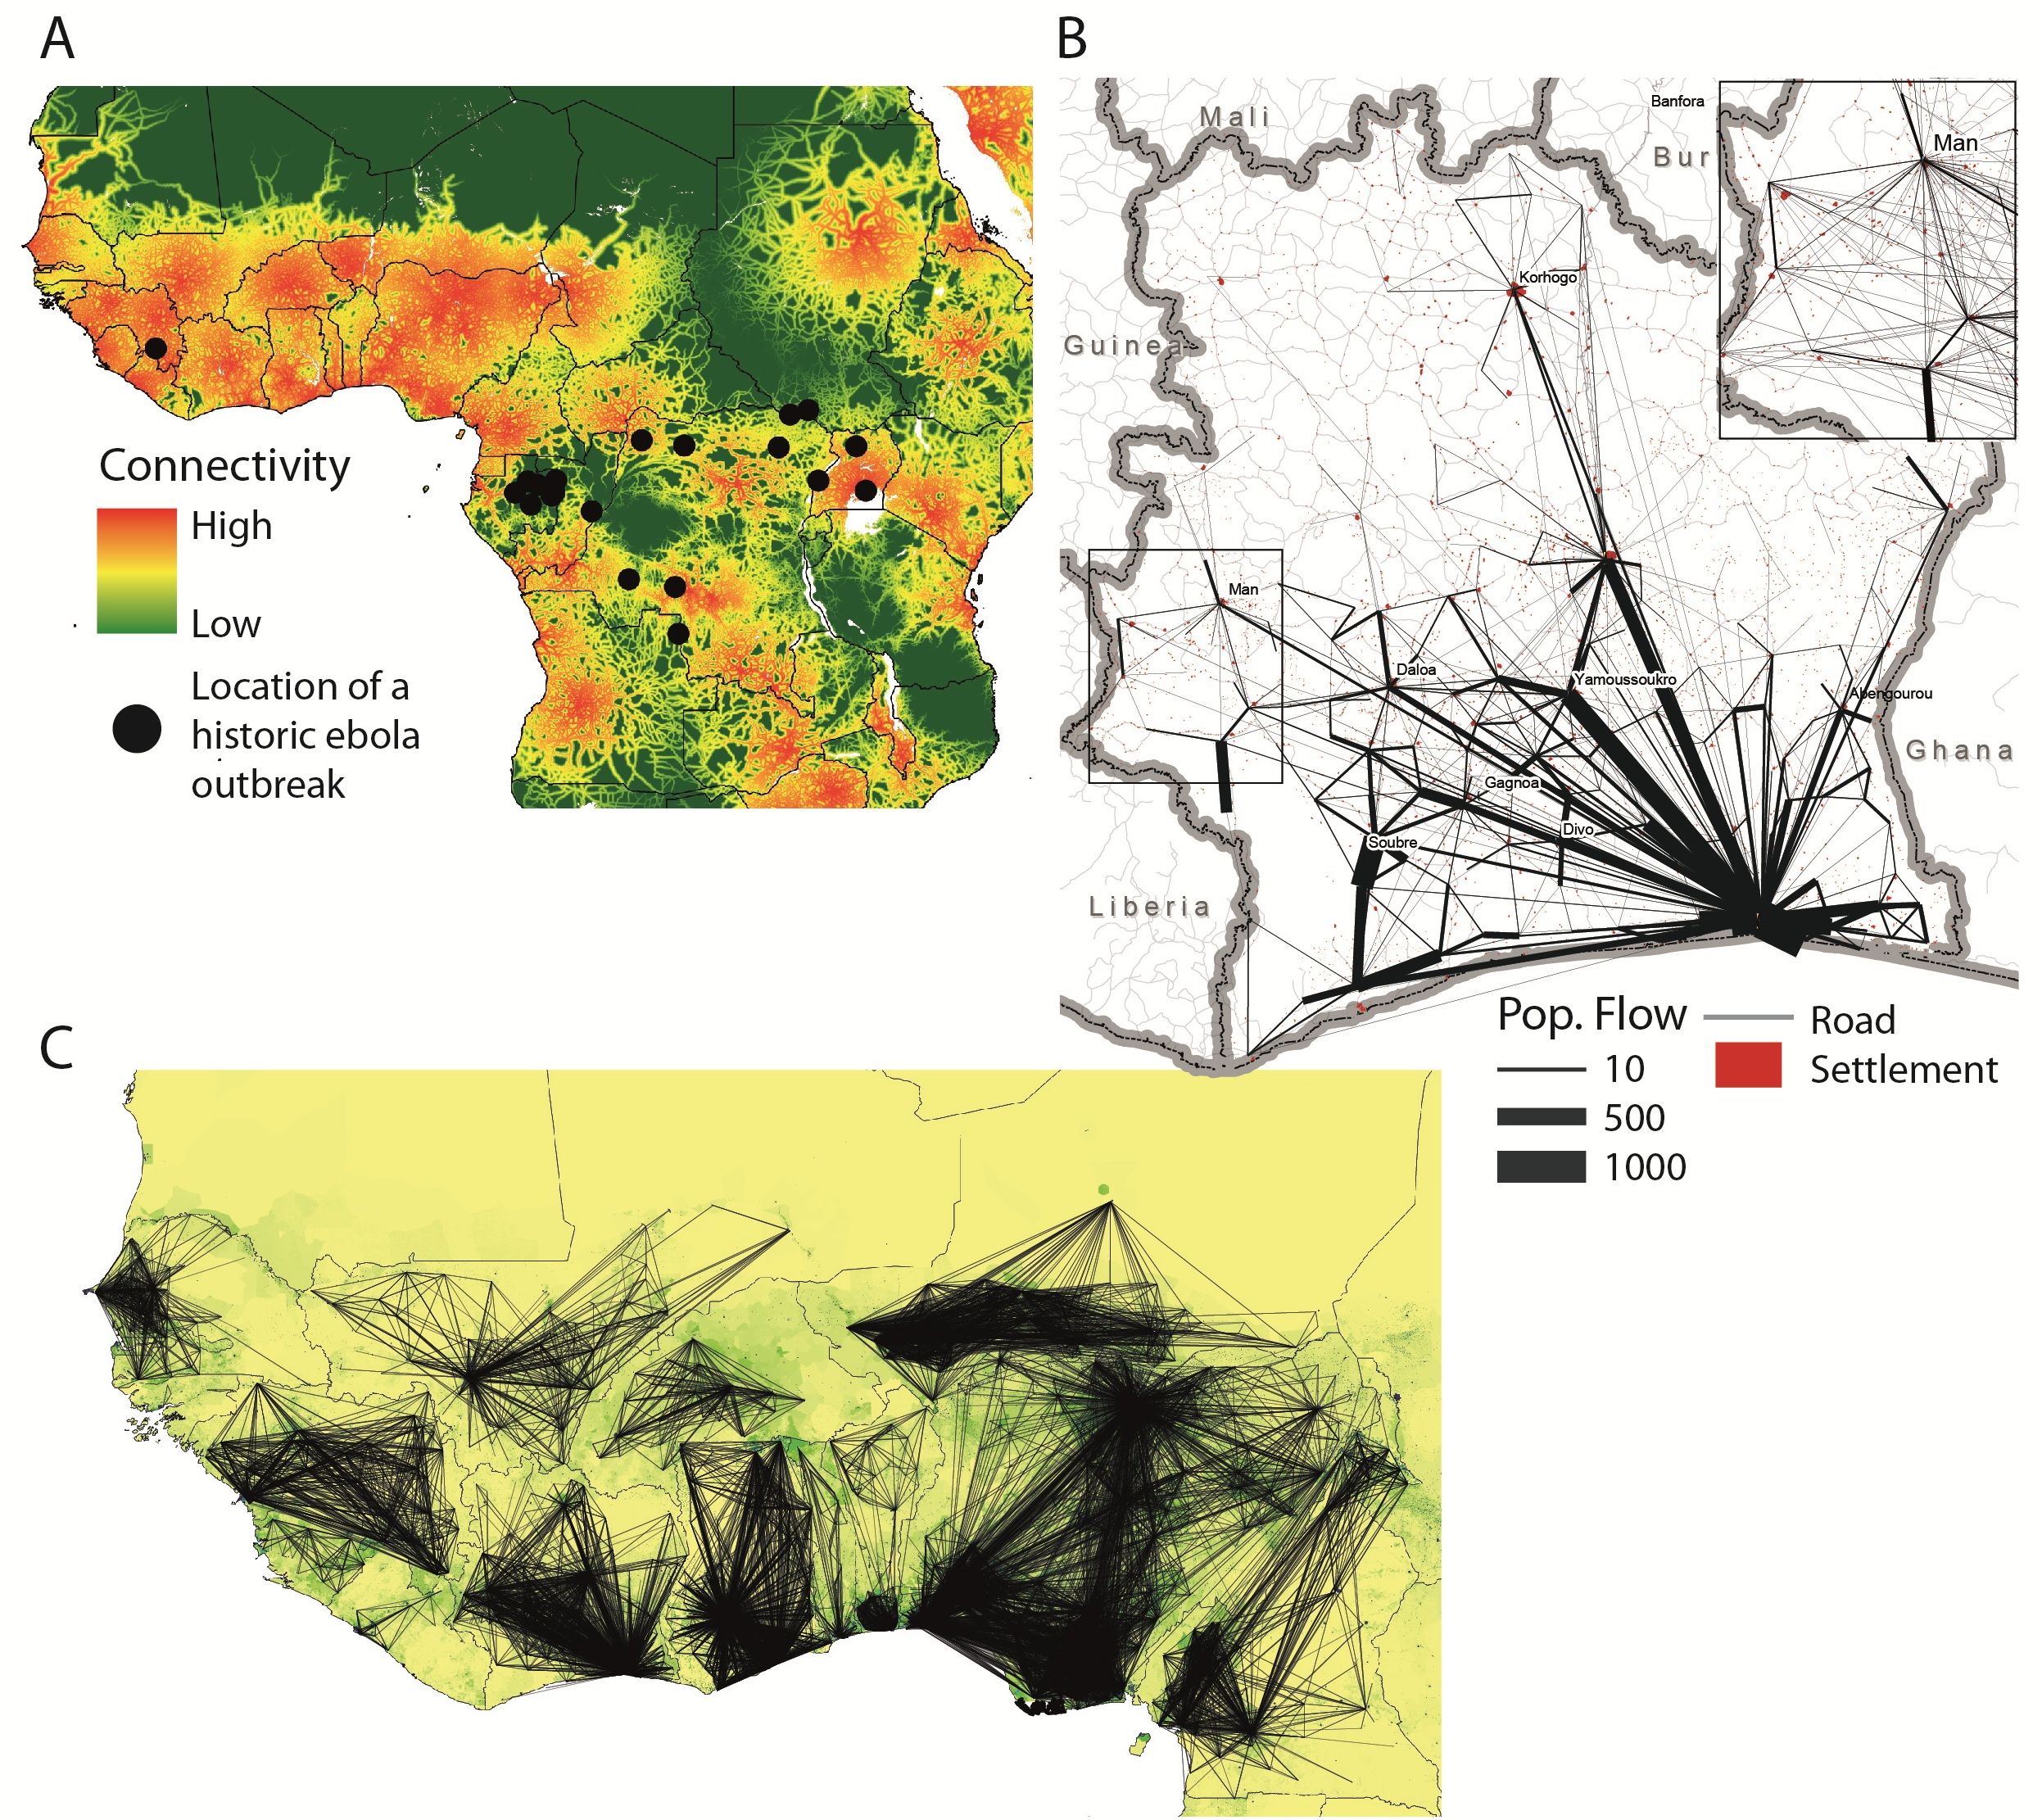
Containing the Ebola Outbreak – the Potential and Challenge of Mobile Network Data

Slide 41
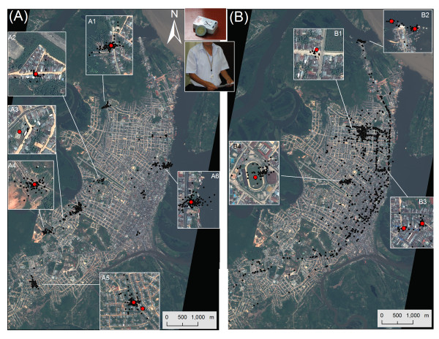
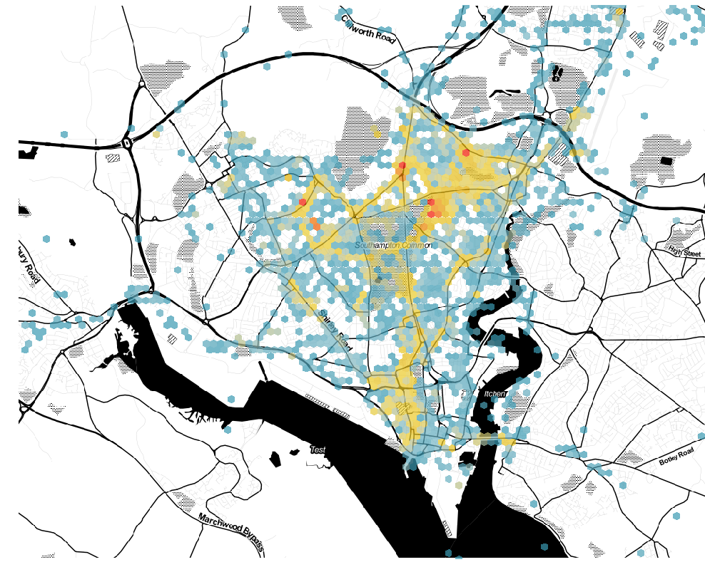
GPS trackers
Provide GPS trackers to participants
+ finescale information, social/demographic/economic context
- very difficult to collect large sample sizes, have to be re-collected, people may forget to carry
GPS tracker data from smartphones may be plausible?

Slide 42
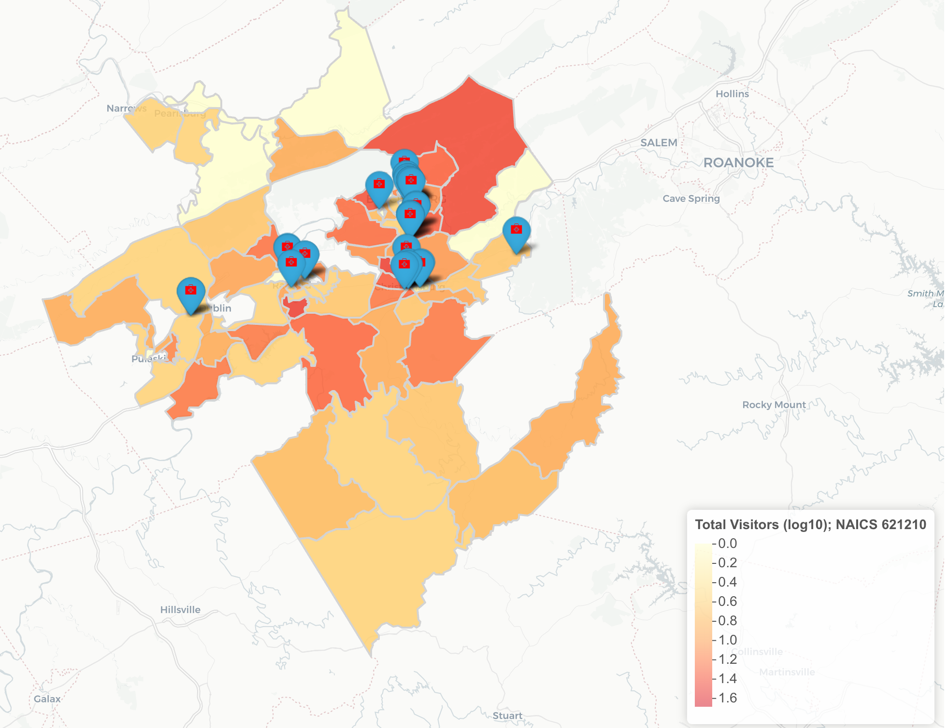
Smartphone data
+ Collecting finescale information passively (in many cases
- Very biased population, increasingly difficult to obtain

Slide 43
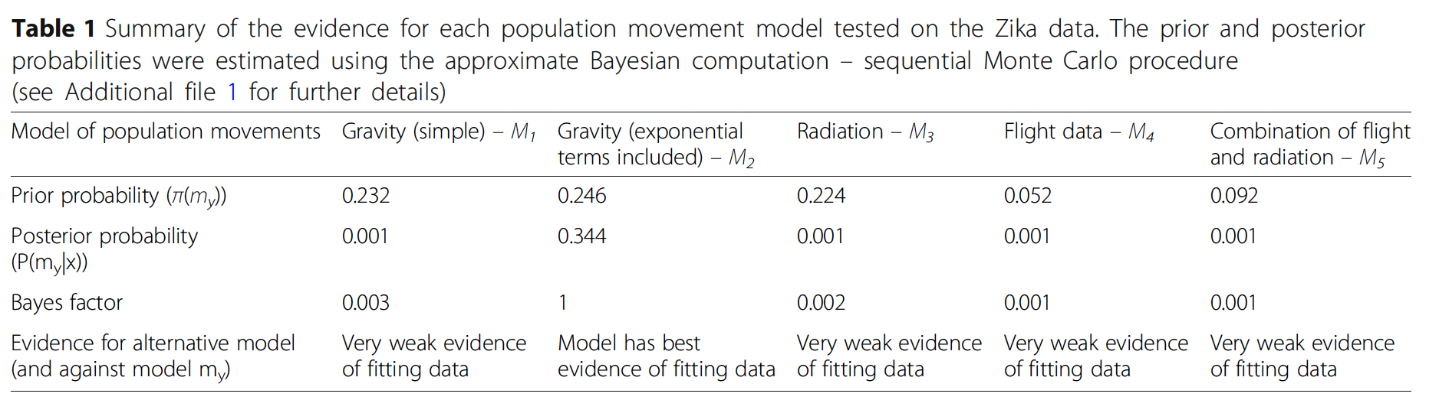
What other options do I have?
There are ways to calculate connectivity without mobility data: Gravity and radiation models
Often, these work as well as actual mobility data!
Flight, mobile phone data… Why might that be?
Projecting the end of the Zika virus epidemic in Latin America: a modelling analysis

Slide 44
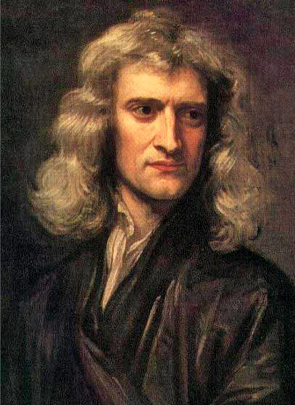
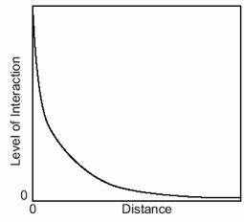
Gravity models
Travel between two places depends on two things
Distance
Distance decay – The further two places are, the fewer people travel
People at each location
Based on Newtons’ formula for gravitational attraction

Slide 45


Gravity models
Travel between locations $i,j$ is a function of population size in both, and distance between the two
$m_{i}$ is the population in $i$
$r_{ij}^{γ}$is the distance between both locations, where gamma is an exponent defining the amount of decay over distance

Slide 46


Radiation models
Considers “opportunities” on the way
Population centers are “opportunities”; the more there are near you, the shorter distances you will travel
$m_{i}$ is the population in $i$, $T_{i}$ is the total number of travelers leaving $i$
$s_{ij}$ is the total population in a radius as far away as $j$ is
The larger $s_{ij}$ is, the larger the denominator; the fewer people will travel to $j$

Slide 47


What about the mosquitoes?
A global assembly of adult female mosquito
mark-release-recapture data to inform the control
of mosquito-borne pathogens
Mosquito travel patterns extremely hard to quantify
Mark-recapture is the gold standard, but very low recapture rates
In models, often either a small diffusion term or no movement of mosquitoes

Slide 48
Summary
Lagrangian models are useful when you have short, frequent trips and no change of residence
We ultimately choose the model formulation last
What data do you have? What communities are you modeling? What interventions are you considering?
There are various sources of mobility data, each with pros/cons
Mobility models can also work well, in place of these datasets
No one clear answer, but it depends on the data available, and their quality

